Slide 1
BDS411: Governance and Politics of Development
SEPTEMBER – DECEMBER 2024
LECTURER: JOHN SELE PHILIP

Slide 2
Course Purpose
To provide students with a comprehensive understanding of the intersection between governance, politics, and socio-economic development from secular and Christian perspectives. The course will explore the impact of local and global politics on nation-building, critically examine various political ideologies, and highlight God’s plan for making a nation prosperous through just governance and ethical leadership.

Slide 3
Expected Learning Outcomes
By the end of the course, students will be able to:
Define empowerment, governance, and politics in secular and theological contexts.
Examine the relationship between politics, governance, and development from a Christian worldview.
Identify and analyze the impact of national and global politics on socio-economic development.
Discuss various political ideologies and their influence on development, with a focus on Judeo-Christian traditions.
Make informed choices and decisions in development planning, considering ethical principles and political trends.

Slide 4
Modes of Delivery
Problem-solving, Class interaction, Lecture, Case study, Presentations, Guest Speakers (Reflective practitioners on the field), weekly Quiz, e-learning option.

Slide 5
ABOUT THE LECTURER
CEO, Content Creators Hub – Leading a global platform for social media growth and monetization.
MDS in Theology of Development Candidate – AIU.
Bachelor of Theology with a Minor in Development Studies – AIU, 2024
Former International Students Representative – Advocated for inclusivity and support at AIU, 2022-2023.
Deputy Vice-Chancellor, Administration – Ascen University, Liberia.
Award-Winning Leader – Recognized for peace advocacy and impactful community development initiatives with an Honorary Title, “Ambassador of Peace”, 2020.
Graduate Assistant (Lecturer) – Department of Development Studies, AIU.
I bring a rich blend of experience in community development, leadership, and governance, aimed at inspiring and preparing you all for impactful roles in development.

Slide 6
Topic 1:
Introduction to Governance, Politics, and Development

Slide 7
Definition and Concepts of Governance, Politics, and Development
Governance
Governance refers to the processes, structures, and institutions through which decisions are made and authority is exercised in a society. It encompasses the mechanisms through which power is distributed and exercised, the management of resources, and the establishment of policies and regulations that guide the actions of individuals, communities, and organizations. Governance is not limited to governmental institutions; it includes non-state actors like civil society organizations, private sector entities, and international bodies (Chambers, 1997).

Slide 8
Continuation…
Effective governance involves principles such as transparency, accountability, participation, rule of law, equity, and responsiveness to the needs of the public. Good governance is considered vital for achieving sustainable development as it ensures that institutions serve the people effectively and efficiently (Todaro, 2000).

Slide 9
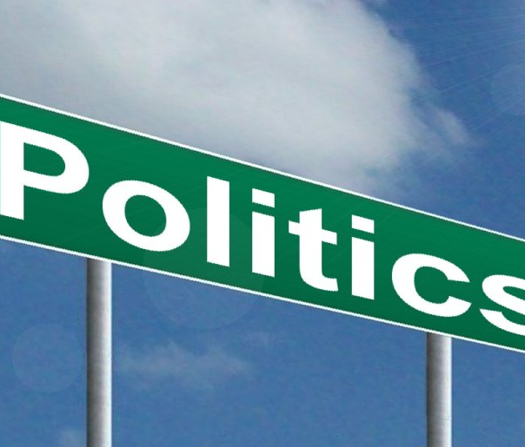
Politics
Politics is the process through which individuals and groups articulate interests, make decisions, and exercise power to achieve specific goals within a given societal context. It involves the negotiation of power, the distribution of resources, and the creation of public policy. Politics operates at various levels—local, national, and international—and includes both formal institutions (such as governments, political parties, and parliaments) and informal actors (such as social movements, lobby groups, and civil society organizations) (Rajaee, 2000).
This Photo by Unknown Author is licensed under CC BY
This Photo by Unknown Author is licensed under CC BY-SA

Slide 10
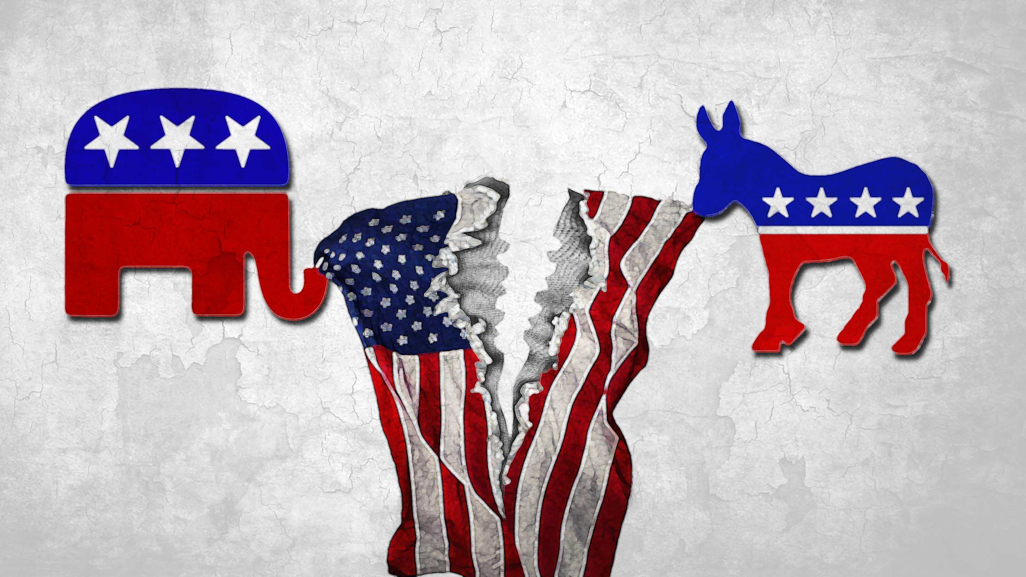
CONTINUATION…
Politics is often viewed as a struggle for power, and it can manifest in various forms, including elections, legislation, advocacy, protest, and dialogue. It is fundamentally about who gets what, when, and how, making it a critical aspect of governance (Miller, 1998).

Slide 11
Development
Development is a multi-dimensional concept that refers to the process of improving the quality of life, reducing poverty, enhancing economic opportunities, and promoting social, political, and cultural progress. Traditionally, development was measured by economic indicators such as Gross Domestic Product (GDP) or per capita income, but contemporary understanding of development includes human development indicators like education, health, equality, and political participation (Todaro, 2000).

Slide 12
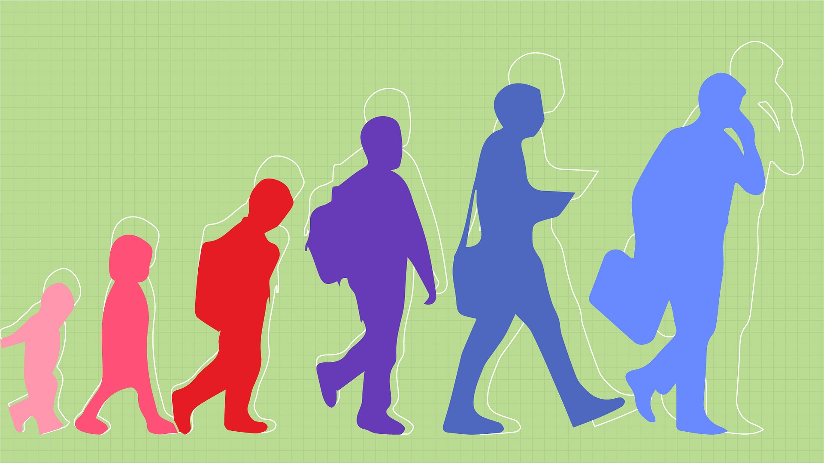
Continuation…
Development is now viewed as a comprehensive process that encompasses not just economic growth but also social, cultural, political, and environmental progress. It involves the expansion of people's freedoms, opportunities, and capabilities to live a fulfilling life (Basiago, 1995).

Slide 13
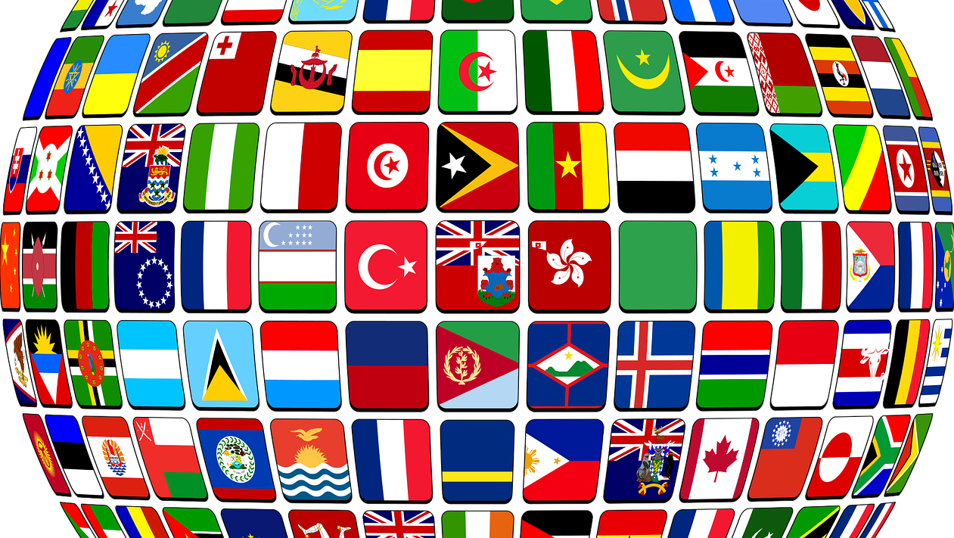
The Interrelation between Governance, Politics, and Development
Governance, politics, and development are deeply interconnected. Governance provides the framework and processes through which political decisions are made and implemented, while politics shapes the governance structures and policies that drive development outcomes. Development, in turn, affects the quality of governance and the nature of political dynamics (Chambers, 1997).

Slide 14
Governance as a Driver of Development
Good governance is a key driver of sustainable development. Transparent and accountable governance structures promote efficient management of resources, reduce corruption, and ensure that development policies are implemented effectively. For instance, democratic governance systems that ensure citizen participation and inclusiveness are more likely to achieve positive development outcomes, as they cater to the needs and aspirations of the broader population (Carlsson, 1987).

Slide 15
Governance Impacts Development Through Multiple Pathways:
Policy Formulation and Implementation: Governance shapes the policy environment, influencing decisions on resource allocation, public spending, and social services.
Institutional Quality: Strong institutions enforce property rights, uphold contracts, and create an enabling environment for economic activities.
Social Cohesion: Governance fosters social cohesion by ensuring fair representation and addressing inequalities within societies.

Slide 16
Politics as a Shaping Force in Governance and Development
Politics shapes governance structures and their effectiveness. Political ideologies, leadership styles, and power dynamics significantly influence governance outcomes and development strategies. For example, authoritarian regimes may prioritize economic growth while neglecting human rights, whereas democratic regimes may focus on inclusive development and social justice (Chambers, 1983).
Political stability is essential for sustained development, as it reduces uncertainty and creates an environment conducive to investment and innovation. Conversely, political instability, corruption, and conflict can severely hamper development by disrupting economic activities, displacing populations, and destroying infrastructure (Todaro, 2000).

Slide 17
Development Influencing Governance and Political Dynamics
Development outcomes can also shape governance and political structures. Rapid economic growth or social progress can lead to demands for more inclusive governance and political reforms. Conversely, underdevelopment and inequality often lead to political instability, social unrest, and conflict, which further undermine governance and development efforts (Miller, 1998).
Development initiatives, such as poverty reduction programs, education, and healthcare improvement, have the potential to empower citizens, reduce inequality, and strengthen democratic governance. Conversely, lack of development or uneven development ca n exacerbate tensions, breed corruption, and lead to social and political upheavals (Rajaee, 2000).

Slide 18
Governance and Development in a Global Context
Globalization has further intertwined governance, politics, and development, creating complex interdependencies among states, international organizations, and non-state actors. Global governance structures, such as the United Nations, the World Bank, and the International Monetary Fund, play a significant role in shaping national development policies and political processes (World Bank, 2002).
Moreover, global challenges like climate change, migration, human trafficking, and pandemics require coordinated governance efforts across national boundaries. Effective global governance and multilateral cooperation are critical for addressing these challenges and achieving sustainable development (Bergdall, 1993).

Slide 19
Summary and Conclusion
Understanding the concepts of governance, politics, and development, and their interrelation is fundamental to comprehending the complexities of nation-building and socio-economic progress. Good governance, informed by ethical principles and inclusive policies, is essential for sustainable development. Meanwhile, politics, as the mechanism through which power is negotiated and exercised, plays a crucial role in shaping both governance structures and development outcomes.
As we progress in this course, we will delve deeper into how these concepts manifest in various political contexts and explore their implications for development from both secular and Christian perspectives.

Slide 20
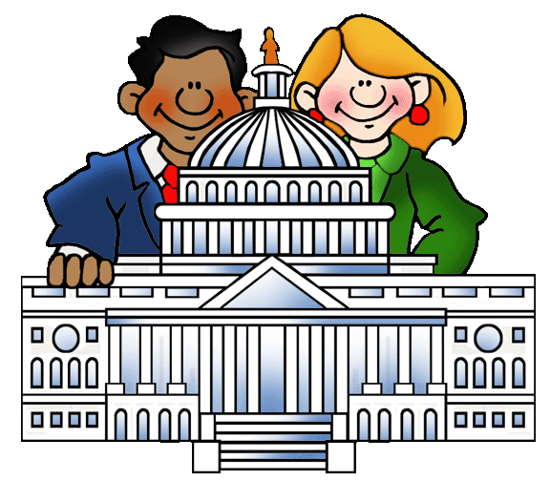
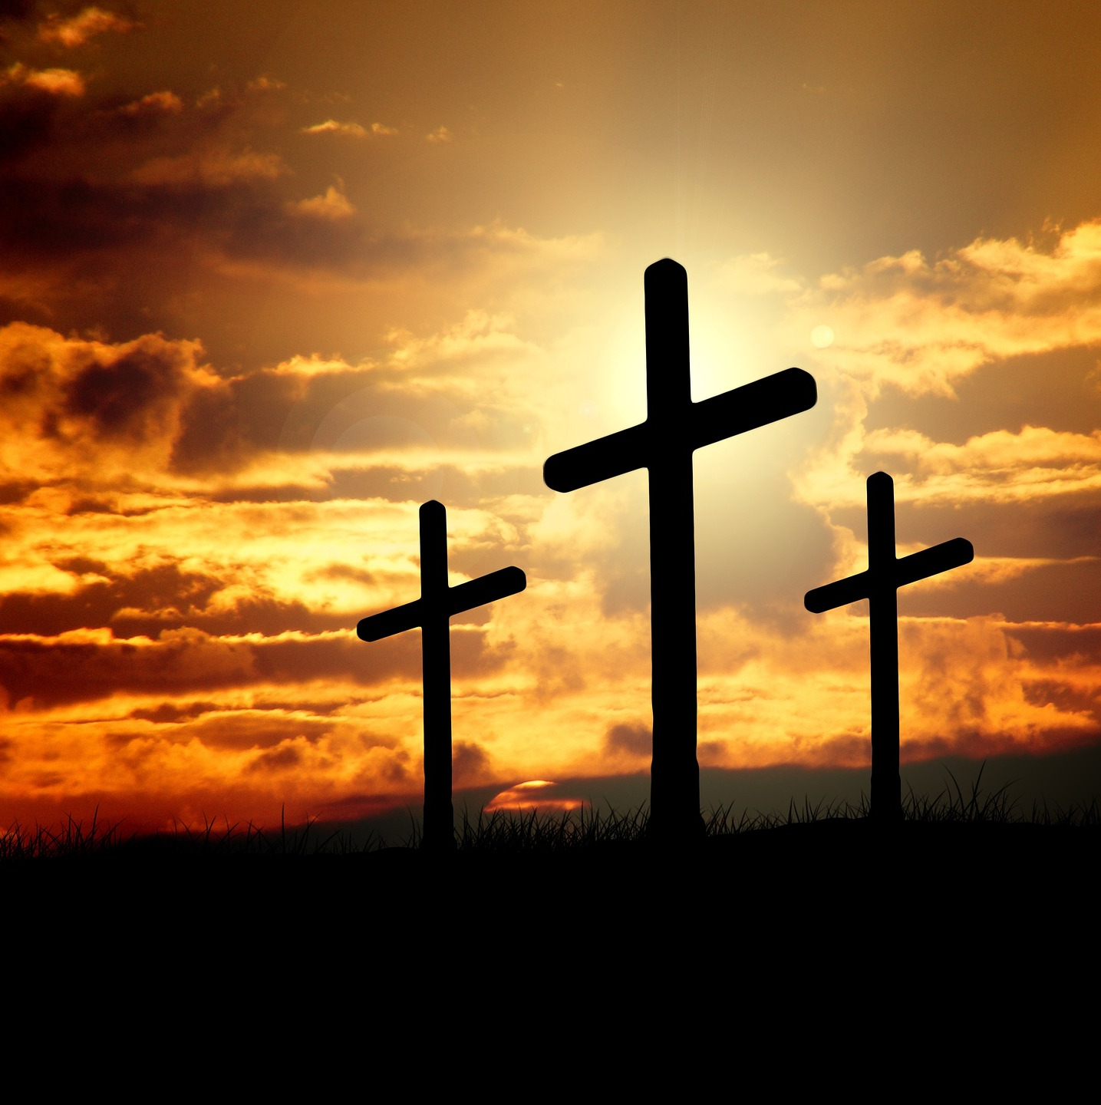
Topic 2: Christian Perspective on Governance and Politics

Slide 21
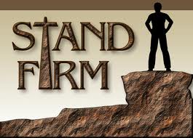
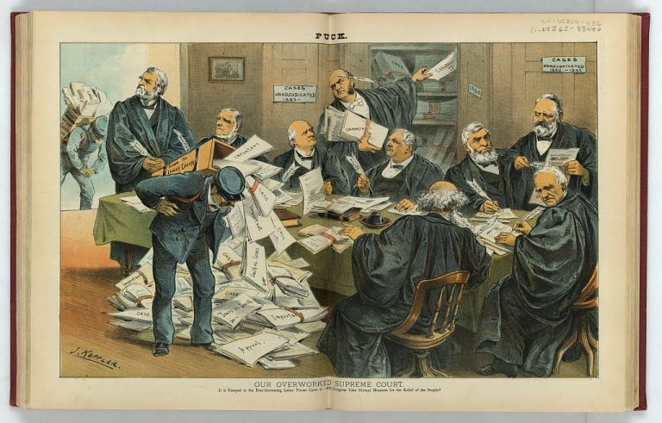
Biblical Foundations of Governance and Politics
Governance in the Old Testament
The Old Testament presents several models of governance that offer insights into the divine purpose for leadership and authority. From the patriarchal leadership of Abraham and Moses to the establishment of the monarchy under Saul, David, and Solomon, governance is depicted as guiding God's people towards His will and purposes.
This Photo by Unknown Author is licensed under CC BY-SA-NC
This Photo by Unknown Author is licensed under CC BY-NC-ND

Slide 22
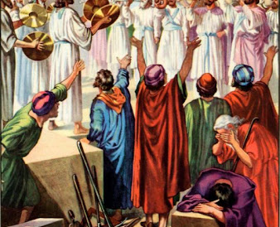
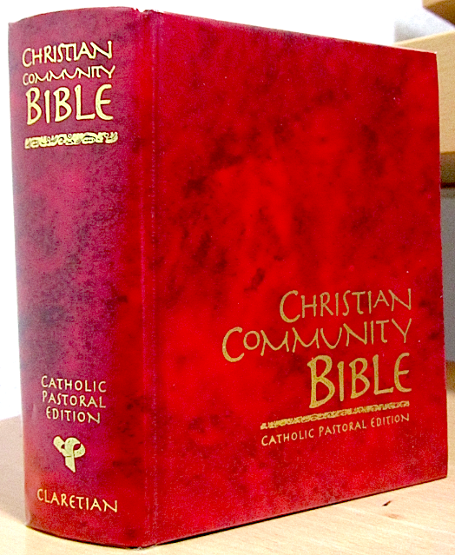
CONTINUATION…
The concept of governance in the Old Testament is rooted in divine sovereignty. God is seen as the ultimate ruler who appoints leaders to govern His people according to His laws. For example, Deuteronomy 17:14-20 lays out specific instructions for the appointment of kings, emphasizing that God should choose rulers, should not be corrupt or self-serving, and should lead according to God’s commandments (Barker, 1995).

Slide 23
CONTINUATION…
The Old Testament also highlights the role of prophets as intermediaries who challenge rulers and hold them accountable to God's standards. Prophets like Nathan, Elijah, and Jeremiah spoke truth to power, critiquing unjust leadership, and calling for repentance and justice (2 Samuel 12:1-15, 1 Kings 18, Jeremiah 22:1-5).

Slide 24
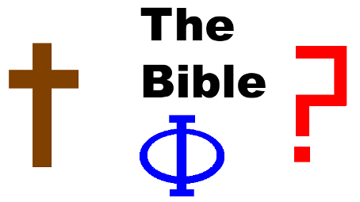
Governance in the New Testament
The New Testament provides a more nuanced understanding of governance in the context of the Roman Empire. Jesus Christ's teachings emphasize a kingdom that is not of this world, suggesting a separation between the spiritual and political realms (John 18:36). However, Jesus also acknowledges the legitimacy of earthly authority when He says, "Render unto Caesar what is Caesar's, and unto God what is God's" (Matthew 22:21).

Slide 25
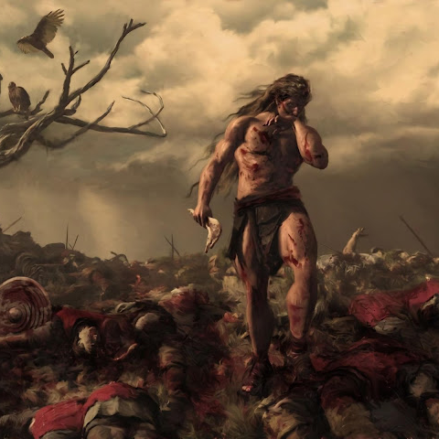
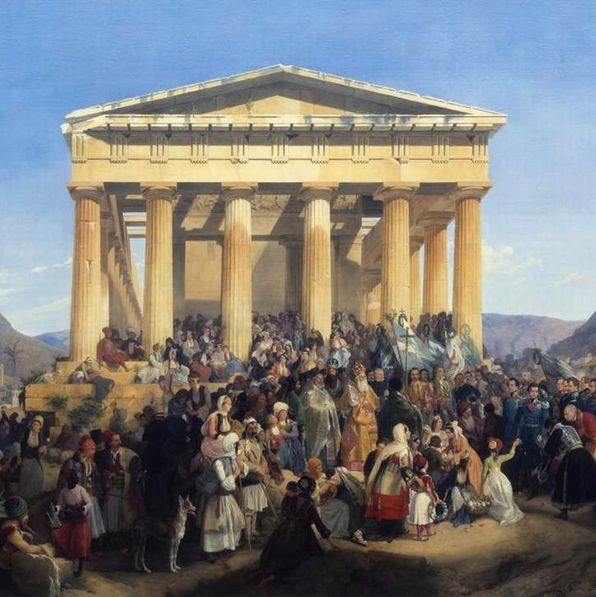
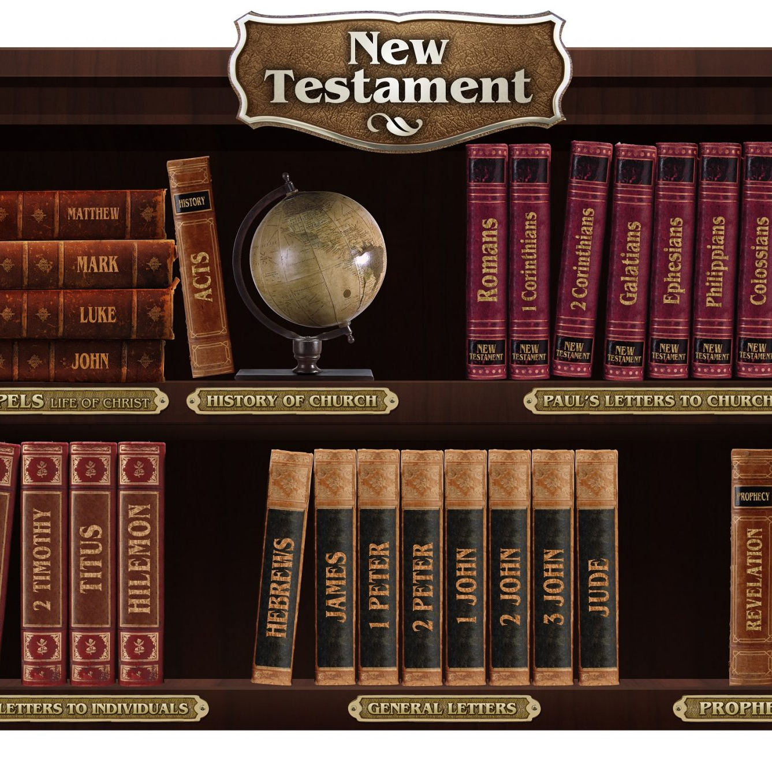
CONTINUATION…
The Apostle Paul further develops this understanding by encouraging Christians to respect and submit to governing authorities, as they are instituted by God to maintain order and justice (Romans 13:1-7). This passage has been foundational in Christian political thought, suggesting that political authority is part of God's providential order. However, Paul also calls for discerning obedience, as governance must align with God's justice and righteousness (Miller, 1998).
This Photo by Unknown Author is licensed under CC BY-SA
This Photo by Unknown Author is licensed under CC BY-NC
This Photo by Unknown Author is licensed under CC BY-NC

Slide 26
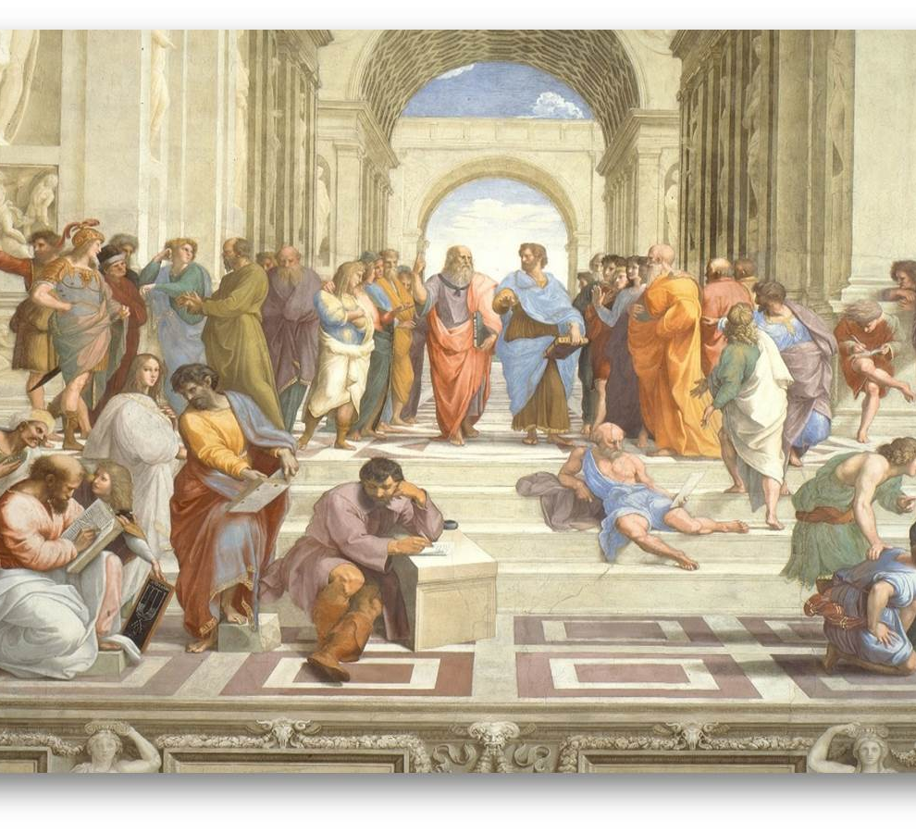
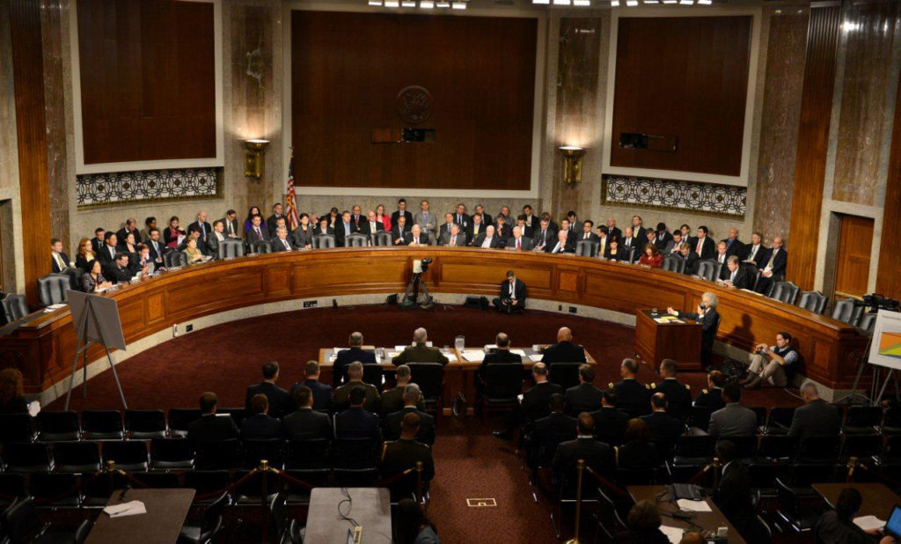
CONTINUATION…
Peter echoes Paul's sentiment, urging Christians to "honor the emperor" while maintaining their ultimate allegiance to God (1 Peter 2:13-17). This dual approach—submission to legitimate authority while maintaining loyalty to God's higher law—forms a core tenet of the Christian perspective on politics and governance.

Slide 27
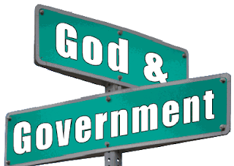
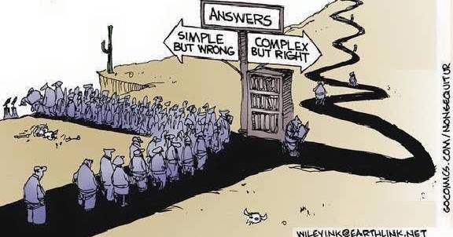
The Role of Christians in Governance and Politics
1. Civic Engagement and Responsibility
Christians are called to be salt and light in the world (Matthew 5:13-16), which implies active participation in societal affairs, including politics and governance. The Christian mandate to love one's neighbor (Mark 12:31) and seek the welfare of the city (Jeremiah 29:7) suggests a responsibility to engage in civic matters that promote justice, peace, and the common good.
The Christian perspective encourages believers to participate in governance not for personal gain but to serve the community, uphold justice, and reflect God's character in public life (Isaiah 1:17). This can involve voting, holding public office, advocating for policies that align with biblical values, and engaging in peaceful protest against unjust laws or practices (Berkouwer, 1960).

Slide 28
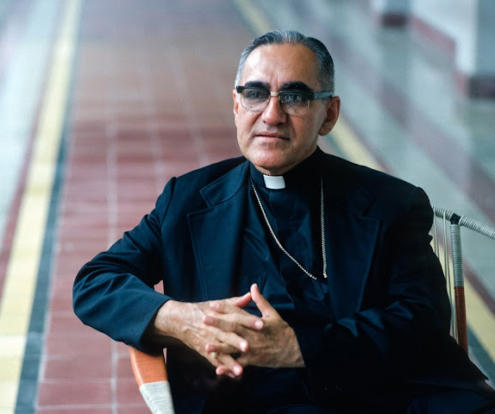
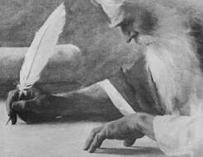
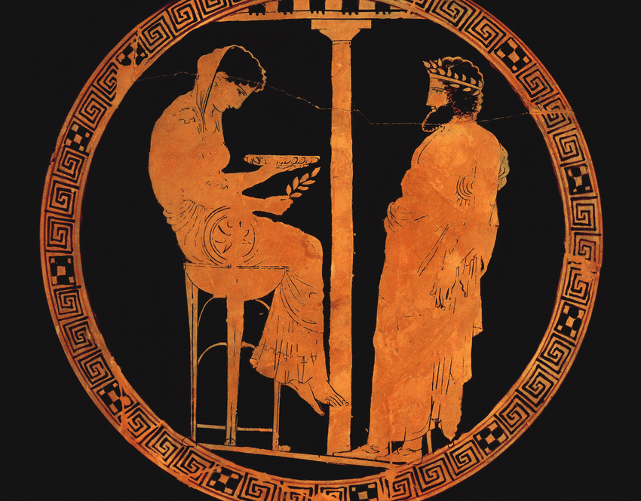
2. Prophetic Role in Society
Christians are also called to serve as a prophetic voice in society, challenging unjust structures, and advocating for the marginalized and oppressed. This involves speaking out against corruption, exploitation, and inequality, much like the prophets of the Old Testament. Martin Luther King Jr., a prominent Christian leader, exemplified this role by using non-violent civil disobedience to challenge racial injustice in the United States (King, 1963).
This prophetic role requires Christians to be well-informed, discerning, and courageous, using their voice and influence to hold leaders accountable and promote governance that reflects biblical principles of justice, mercy, and humility (Micah 6:8).

Slide 29
Theological Principles Guiding Governance and Politics

Slide 30
1. The Principle of Justice
The Bible consistently emphasizes justice as a fundamental principle of governance. Scriptures such as Isaiah 1:17 ("Learn to do right; seek justice. Defend the oppressed") and Amos 5:24 ("But let justice roll on like a river, righteousness like a never-failing stream!") highlight the importance of justice in God's kingdom. Christian thought thus argues that any form of governance must prioritize justice, fairness, and the protection of human dignity (Carlson-Thies, 2004).
Justice, in the Christian worldview, is not merely legal correctness but a reflection of God's character. It involves defending the rights of the poor, widows, orphans, and strangers, ensuring that governance serves the common good and prevents the abuse of power (Psalm 82:3-4, Proverbs 31:8-9).

Slide 31
2. The Principle of Stewardship
Christian theology views political authority as a form of stewardship, where leaders are entrusted with the responsibility of managing resources, power, and authority for the benefit of all. According to the parable of the Talents (Matthew 25:14-30), those in positions of authority must use their power wisely and for the greater good, knowing they are accountable to God for their actions (Marshall, 1984).
This principle calls for leaders to practice servant leadership, reflecting Christ's example of humility and self-sacrifice (Mark 10:42-45). It also calls for accountability, transparency, and integrity in public office, recognizing that all authority ultimately belongs to God (Psalm 24:1).

Slide 32
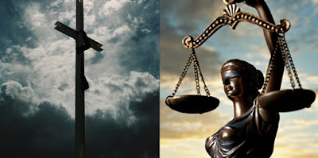
3. The Principle of Peace and Reconciliation
Christian teachings emphasize peace and reconciliation as vital components of governance. Jesus' declaration in the Beatitudes, "Blessed are the peacemakers" (Matthew 5:9), indicates that Christians are to actively promote peace and resolve conflicts. Political engagement should therefore aim to bring reconciliation, heal divisions, and foster unity within society (Yoder, 1972).
Christians are encouraged to advocate for policies that promote peace, protect human rights, and provide justice for all. This includes working to resolve conflicts peacefully, supporting diplomatic efforts, and encouraging dialogue between opposing factions (Romans 12:18).

Slide 33
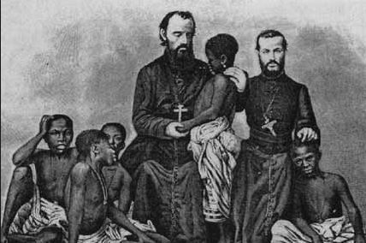
Christian Perspective on Modern Political Systems

Slide 34
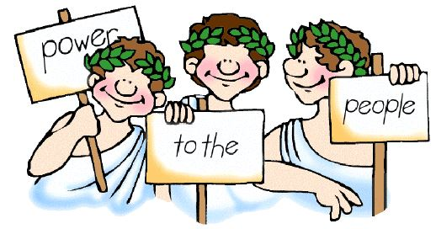
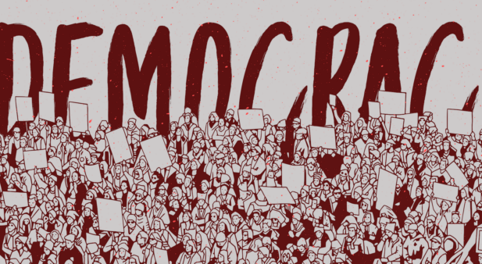
Democracy and Christian Values
From a Christian perspective, democracy is often seen as compatible with biblical principles because it allows for freedom, participation, and accountability. The principle of human dignity, which recognizes that all people are made in the image of God (Genesis 1:27), aligns with democratic ideals of equality, justice, and the right to participate in governance (Ruth, 2002).
However, Christian engagement in democracy is not uncritical. It requires discerning participation that promotes God's righteousness and justice while challenging policies and practices that contradict biblical teachings (Carlsson, 1987).

Slide 35
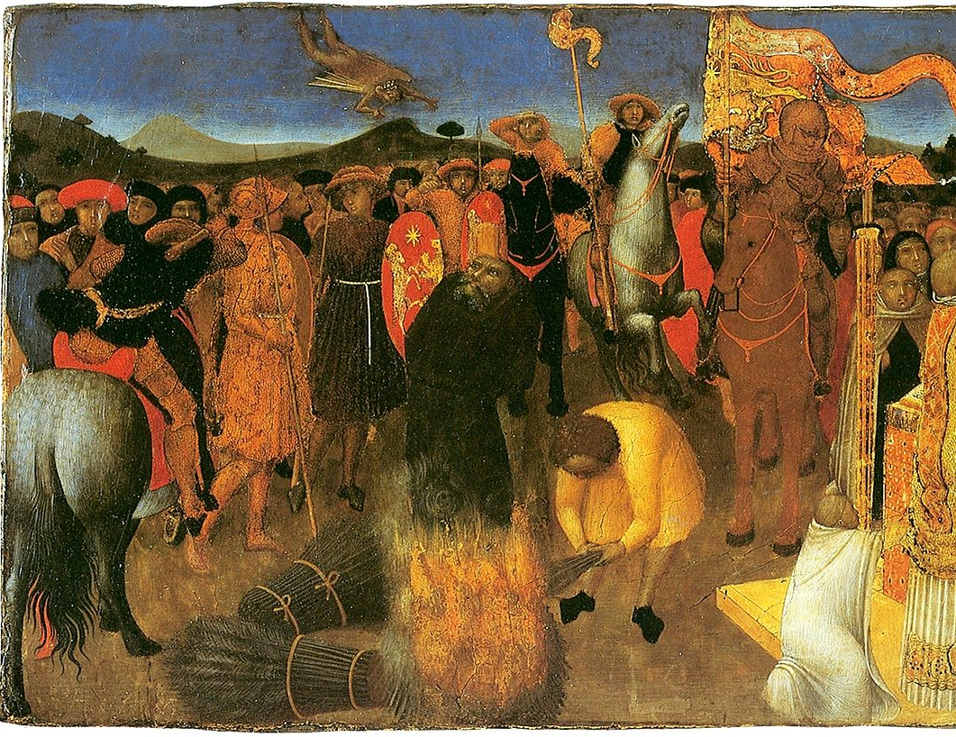
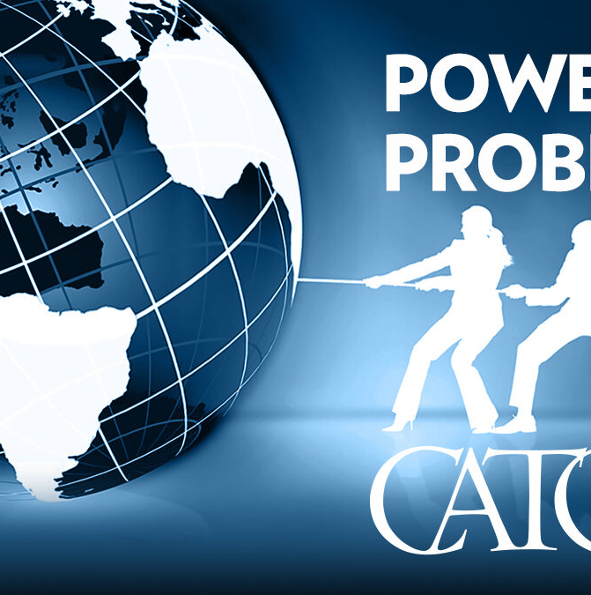
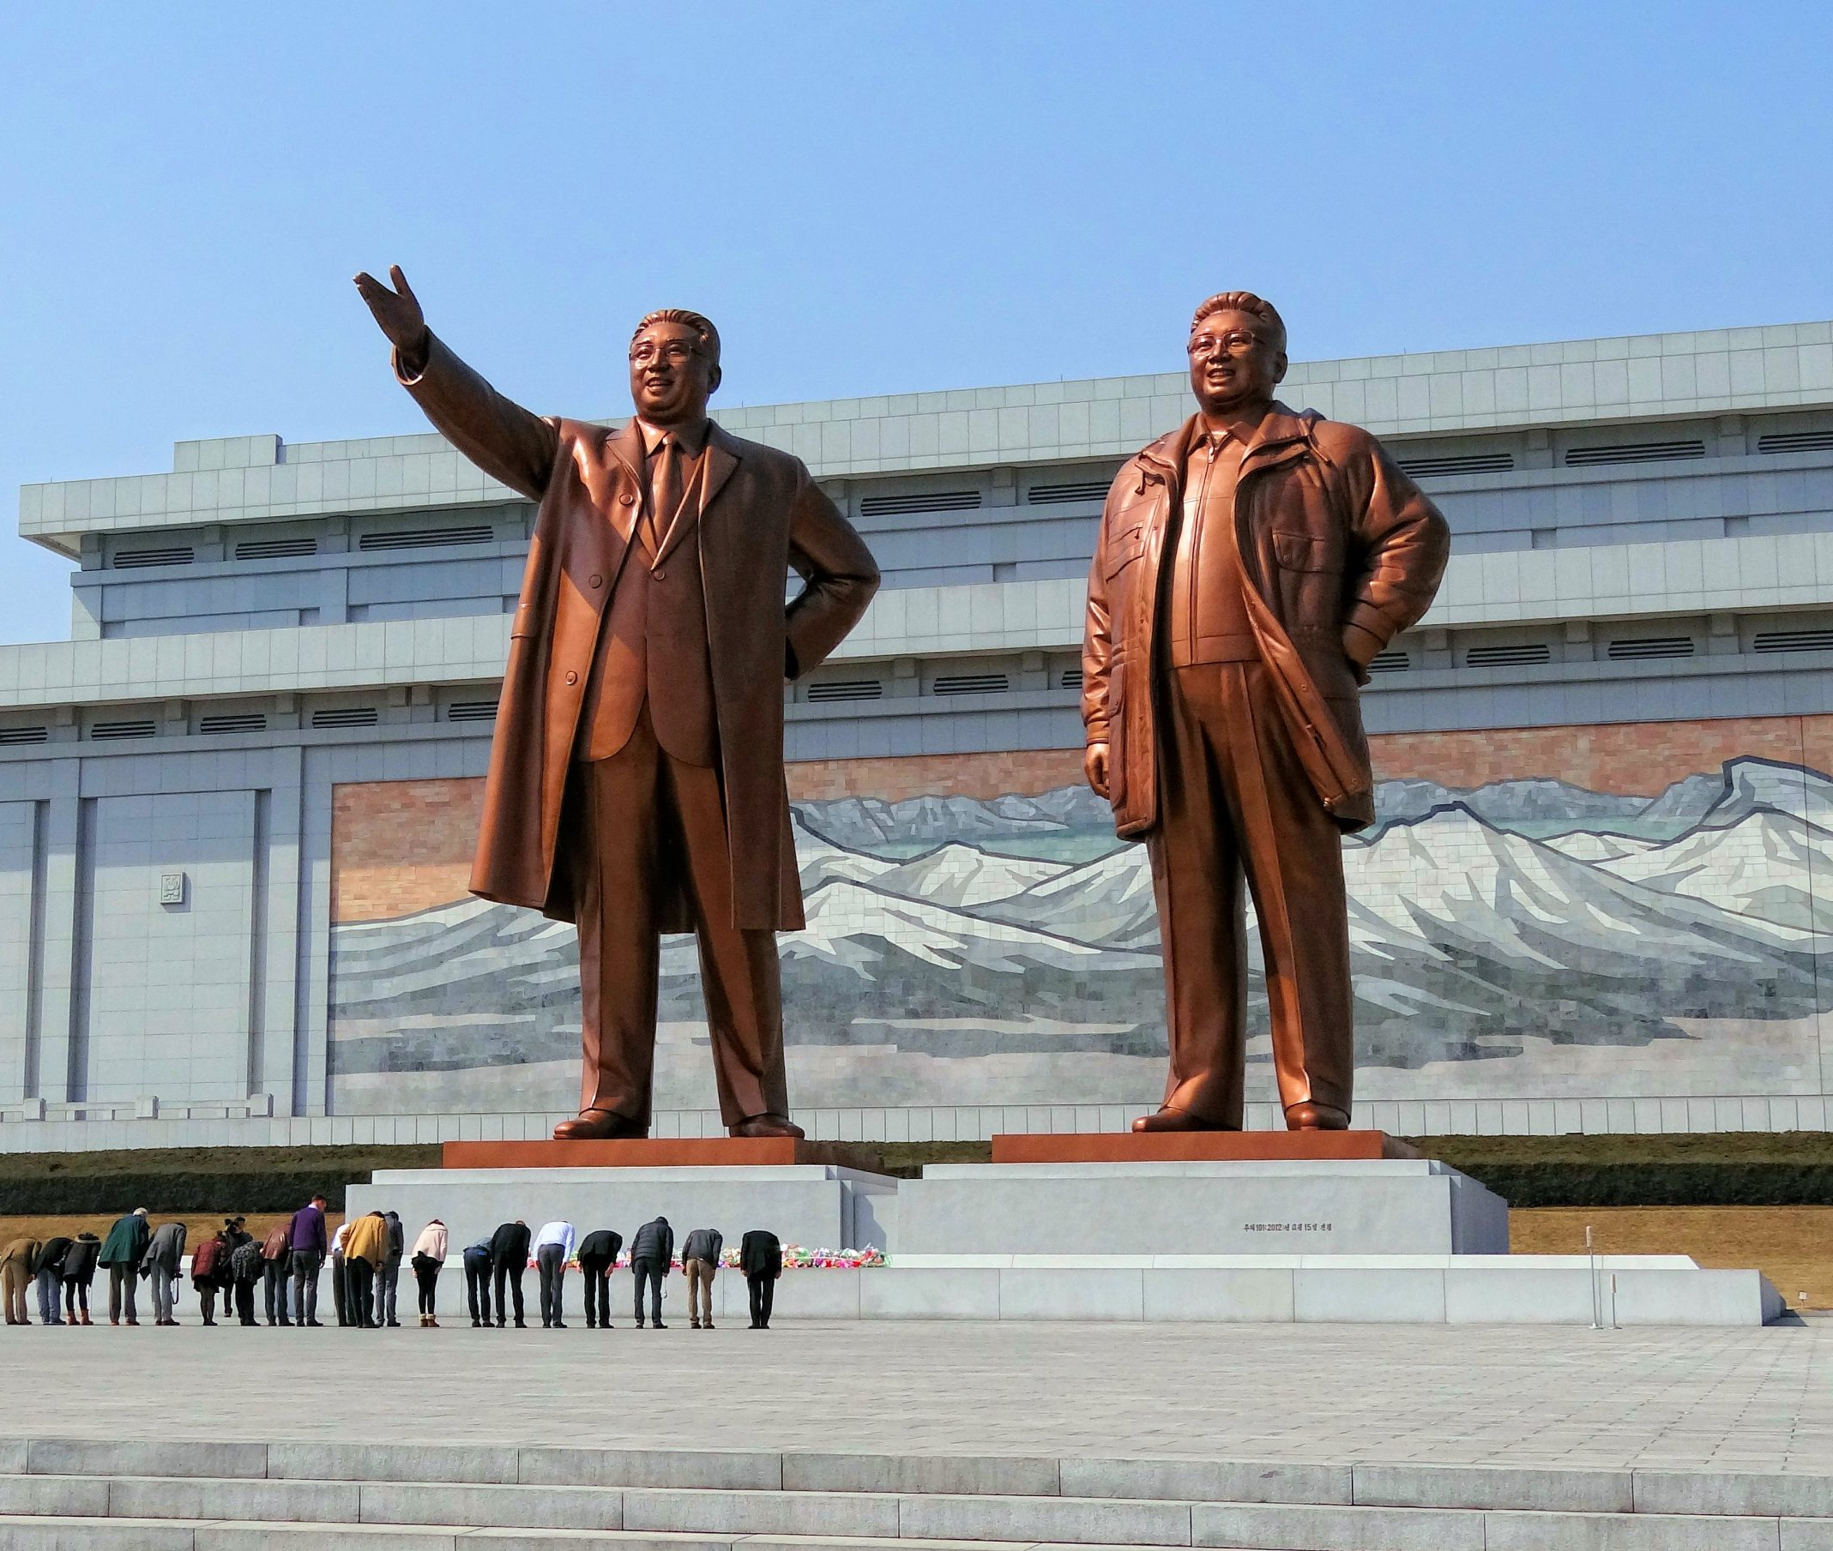
Christian Views on Authoritarian Regimes
Christian thought generally critiques authoritarian regimes that suppress freedom, violate human rights, and perpetuate injustice. Historical examples, such as the resistance against apartheid in South Africa or the opposition to Communist regimes in Eastern Europe, demonstrate the Christian call to resist unjust authority and promote governance that respects human dignity and freedom (Bonhoeffer, 1953).

Slide 36
Conclusion: A Call to Faithful Engagement
Christians are called to a dual role in governance and politics: to submit to authorities as instituted by God while simultaneously serving as a prophetic voice for justice, peace, and the common good. The Christian perspective encourages active, informed, and discerning engagement in political processes, always aligning with the values of God’s kingdom.
As followers of Christ, believers are urged to participate in governance not for power or personal gain but to serve their communities, uphold justice, and reflect God's righteousness in the public sphere.
This Photo by Unknown Author is licensed under CC BY-NC-ND
This Photo by Unknown Author is licensed under CC BY-NC-ND
This Photo by Unknown Author is licensed under CC BY-SA-NC

Slide 37
Topic 3: Power Dynamics in Society

Slide 38
Understanding Power
Definition and Concept of Power
Power is a fundamental concept in social sciences and political theory. It refers to the capacity of individuals or groups to influence or control the actions, beliefs, or behaviors of others. Power can be categorized into various forms, including:

Slide 39
Continuation…
Coercive Power: The ability to enforce compliance through threats or punishment (French & Raven, 1959).
Reward Power: The capability to distribute rewards or benefits as a means of influence (Raven & French, 1958).
Legitimate Power: Power derived from an official position or role within a structured hierarchy (Raven & French, 1958).
Referent Power: Influence based on admiration or respect, often associated with charismatic leaders (French & Raven, 1959).
Expert Power: Power stemming from expertise or knowledge in a particular area (Raven & French, 1958).

Slide 40
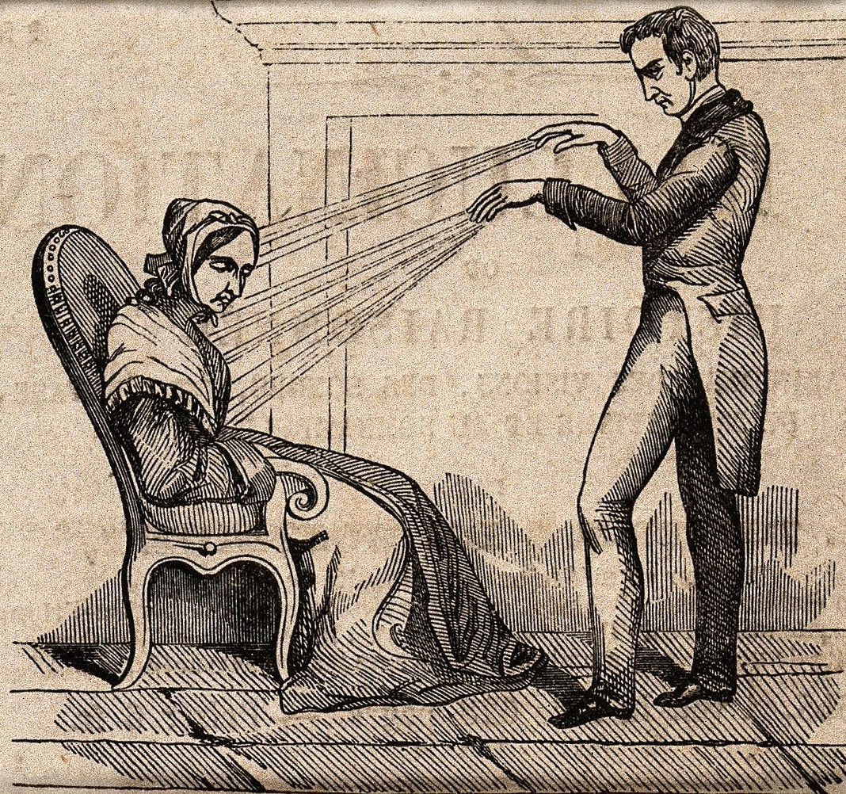
Theories of Power
Several theories explain how power operates and is distributed within societies:
Max Weber's Theory of Authority: Weber distinguished between three types of authority: traditional, charismatic, and legal-rational. Each type reflects different sources and legitimacy of power (Weber, 1947).
Michel Foucault's Theory of Power: Foucault proposed that power is decentralized and pervasive, existing in various forms throughout society, not just in institutions but also in everyday social practices (Foucault, 1978).
Steven Lukes' Three Dimensions of Power: Lukes identified three dimensions of power: decision-making power, non-decision-making power, and the power to shape desires and beliefs (Lukes, 2005).

Slide 41
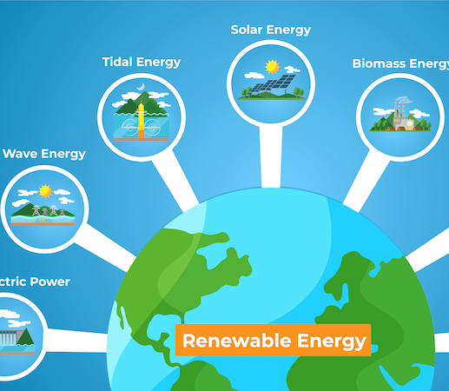
Sources of Power
Institutional Power
Institutions such as governments, corporations, and religious organizations hold significant power through their formal structures and roles. This power is derived from legal authority, organizational control, and the ability to enforce rules and policies (Scott, 2001).

Slide 42
Continuation…
Political Institutions: Governments and political entities have the authority to make and enforce laws, allocate resources, and govern society (Dahl, 1989).
Economic Institutions: Corporations and financial institutions wield power through economic control, market influence, and employment (Friedman, 1962).
Religious Institutions: Religious organizations influence societal values, norms, and ethics through spiritual authority and community leadership (Berger, 1967).

Slide 43
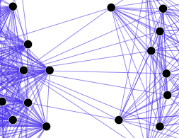
Social Power
Social power emerges from informal networks, cultural norms, and interpersonal relationships. This includes:
Social Capital: The value derived from social networks, trust, and community reciprocity (Putnam, 2000).
Cultural Power: The influence of cultural norms, media, and public discourse in shaping societal attitudes and behaviours (Gramsci, 1971).

Slide 44
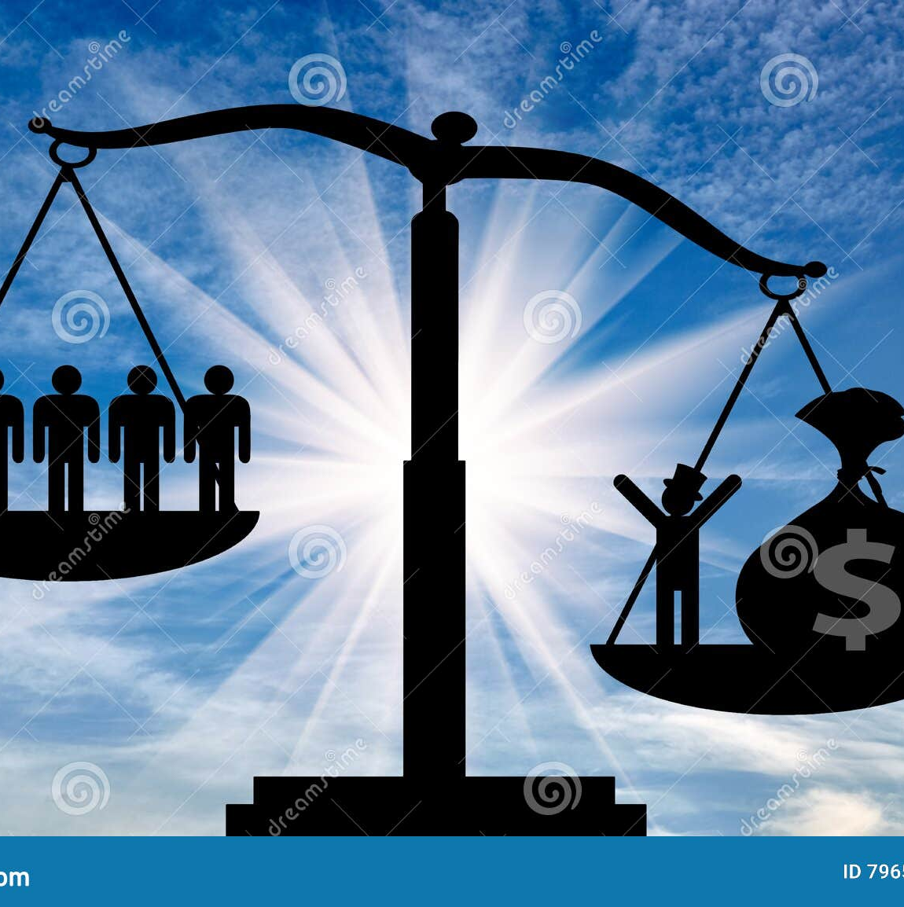
Economic Power
Economic power is the control over resources, wealth, and production. It manifests in:
Wealth Distribution: The concentration of wealth in the hands of a few individuals or entities influences social inequality and access to opportunities (Piketty, 2014).
Corporate Influence: Large corporations can shape economic policies, consumer behaviors, and labor conditions (Korten, 2001).

Slide 45
Manifestations of Power
Political Power
Political power manifests through governance, law-making, and enforcement. It involves the ability to influence political decisions, policy formulation, and public administration (Held, 2006).
Policy Influence: Political leaders and lobbyists can shape legislation and government priorities (Berry & Wilcox, 2009).
Electioneering: The process of campaigning and influencing voter behavior is a critical aspect of political power (Downs, 1957).
This Photo by Unknown Author is licensed under CC BY-NC

Slide 46
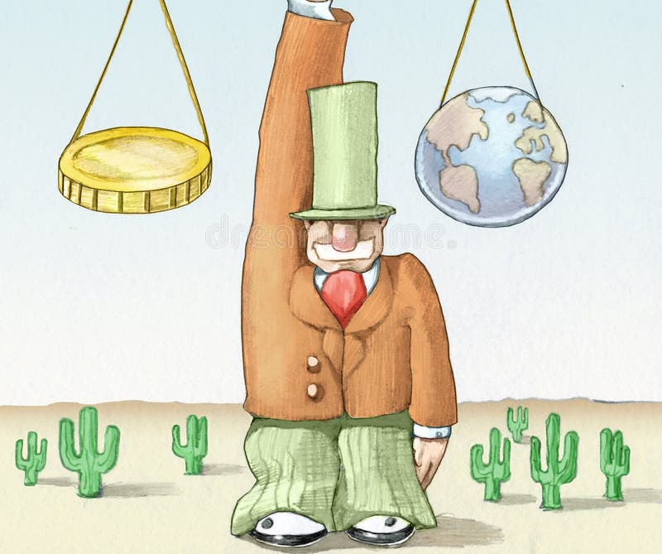
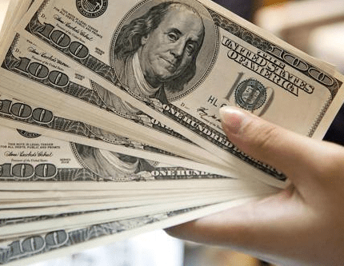
Economic Power
Economic power is exercised through market control, investment decisions, and corporate strategies. It affects:
Market Dominance: Large firms can control market prices, product availability, and competition (Stigler, 1968).
Labor Relations: Economic power influences labor practices, wages, and working conditions (Marx, 1867).

Slide 47
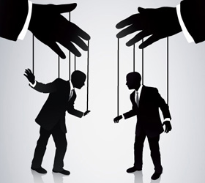
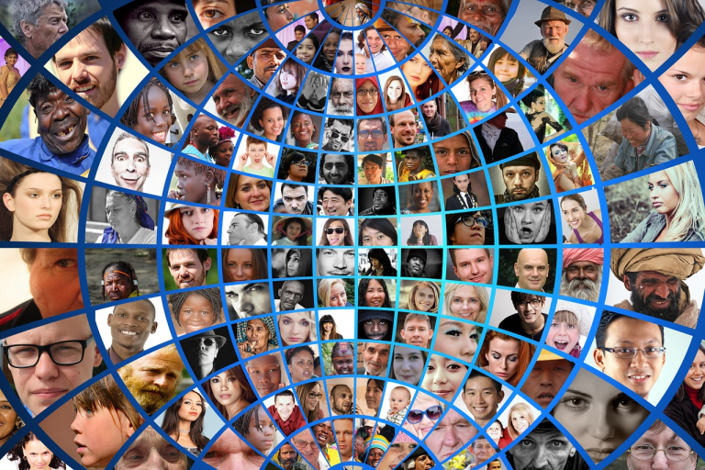
Social and Cultural Power
Social and cultural power shapes societal values, norms, and identities through:
Media Influence: Media outlets and cultural products influence public perceptions, trends, and values (McLuhan, 1964).
Education Systems: Educational institutions shape knowledge, skills, and socialization processes (Bowles & Gintis, 1976).
This Photo by Unknown Author is licensed under CC BY-NC-ND
This Photo by Unknown Author is licensed under CC BY

Slide 48
Implications of Power Dynamics
Power and Inequality
Power dynamics contribute to social inequality by creating and reinforcing disparities in wealth, opportunity, and access to resources. This can lead to systemic discrimination and marginalization of certain groups (Sen, 1999).
Economic Disparities: Concentration of economic power leads to wealth inequality and affects social mobility (Piketty, 2014).
Social Exclusion: Certain groups may experience exclusion from social and economic opportunities due to power imbalances (Young, 1990).

Slide 49
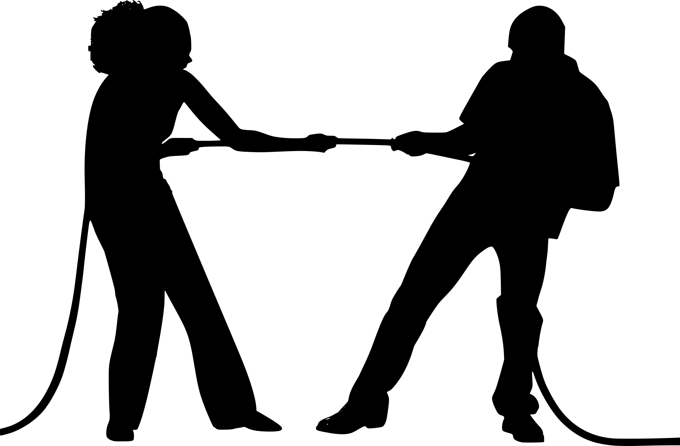
Power and Conflict
Power imbalances can lead to social and political conflicts, as marginalized groups challenge dominant power structures and advocate for justice and equity (Tilly, 2003).
Revolution and Protest: Social movements and revolutions often arise from power struggles and demands for change (Arendt, 1969).
Negotiation and Compromise: Effective conflict resolution requires negotiation and compromise between conflicting power interests (Fisher & Ury, 1981).

Slide 50
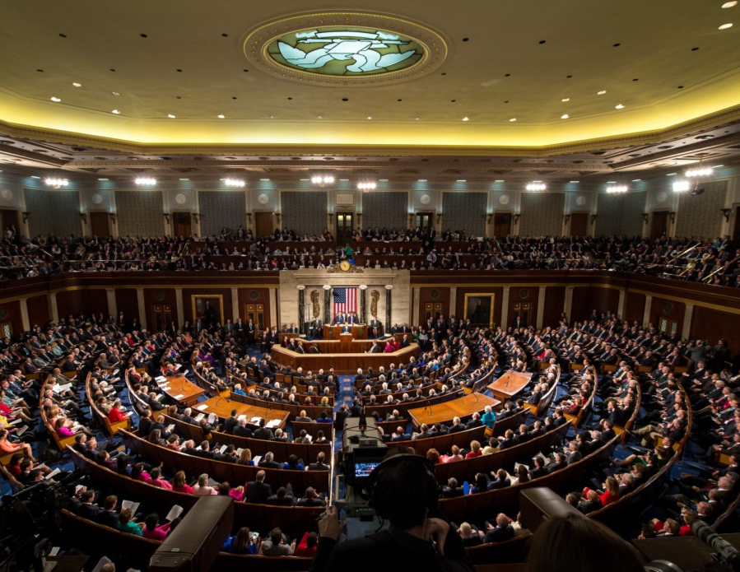
Power and Governance
Governance structures must address power dynamics to ensure fairness, transparency, and accountability. This involves:
Checks and Balances: Implementing systems to prevent abuse of power and ensure balanced decision-making (Madison et al., 1788).
Participatory Governance: Encouraging broad participation in decision-making processes to represent diverse interests (Arnstein, 1969).
This Photo by Unknown Author is licensed under CC BY
This Photo by Unknown Author is licensed under CC BY-SA-NC
This Photo by Unknown Author is licensed under CC BY

Slide 51
Case Studies and Examples

Slide 52
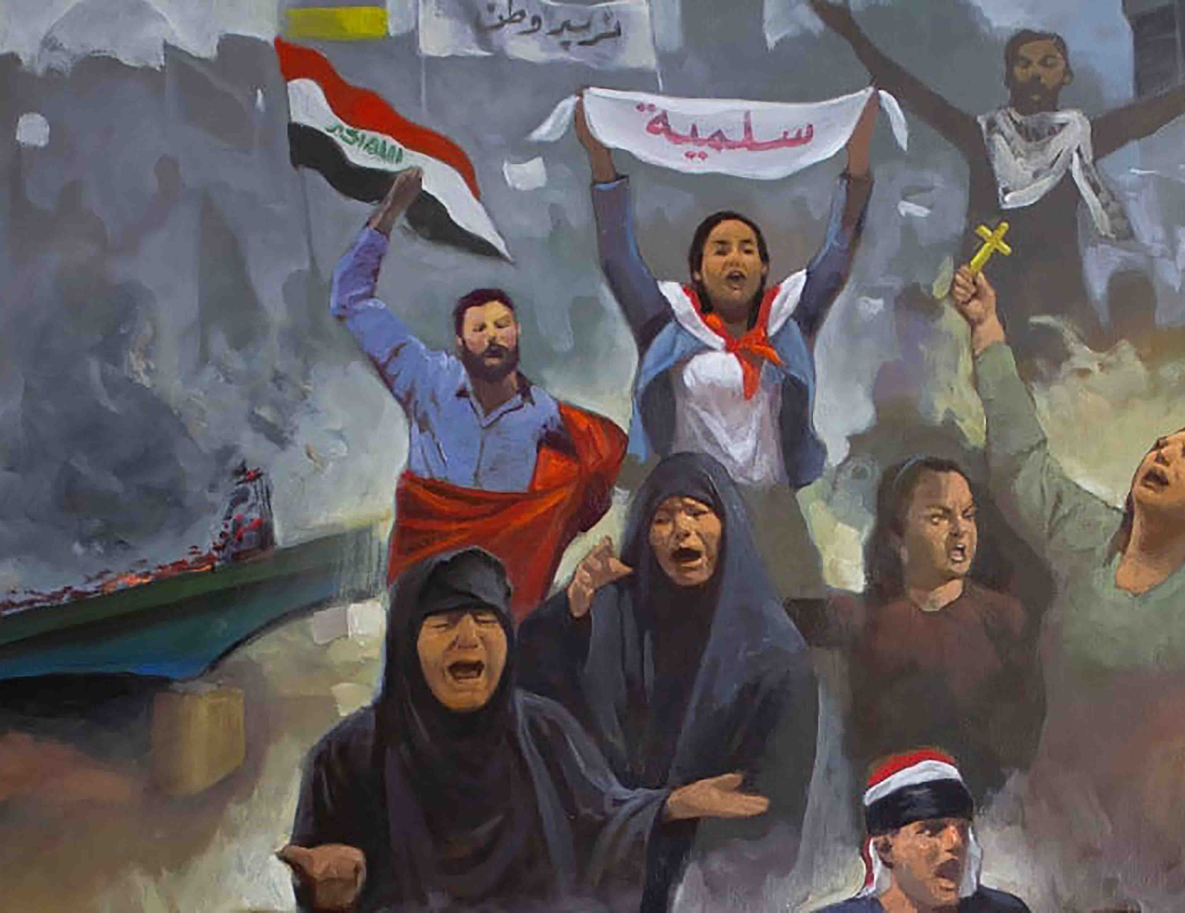
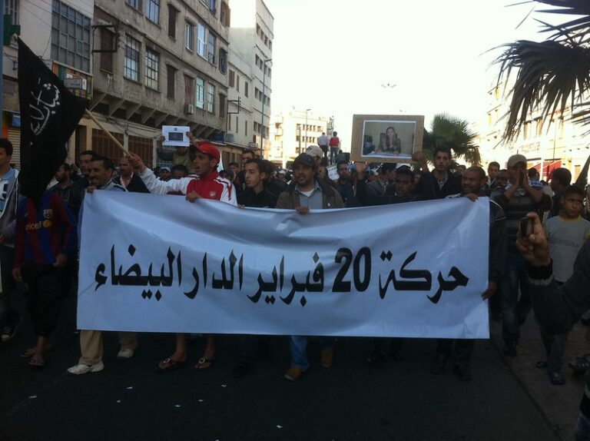
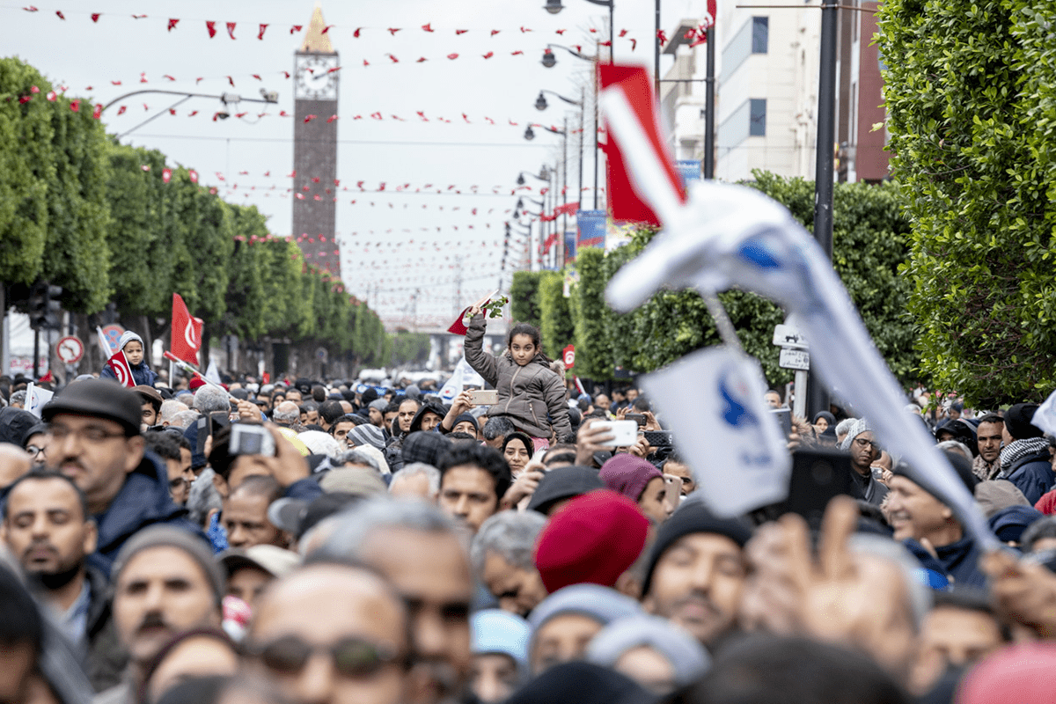
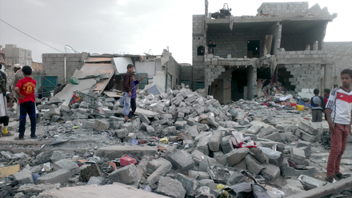
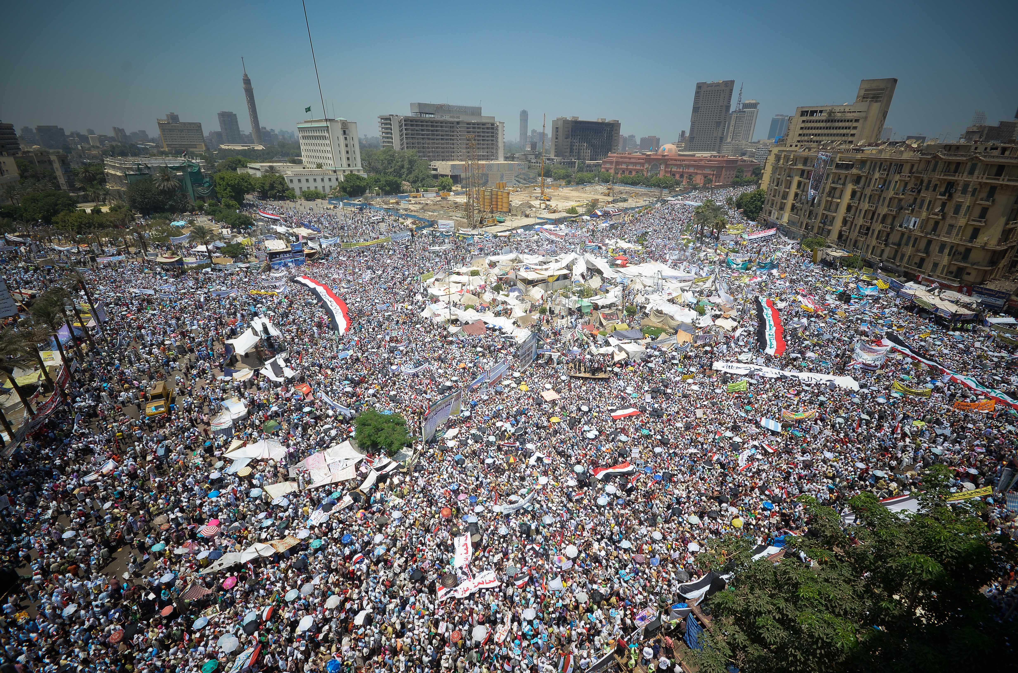
Case Study: The Arab Spring
The Arab Spring exemplifies the impact of power dynamics on social and political change. Popular uprisings in the Arab world challenged authoritarian regimes and highlighted issues of power, inequality, and governance (Anderson, 2011).
This Photo by Unknown Author is licensed under CC BY-SA-NC
This Photo by Unknown Author is licensed under CC BY-SA
This Photo by Unknown Author is licensed under CC BY-NC
This Photo by Unknown Author is licensed under CC BY-SA
This Photo by Unknown Author is licensed under CC BY-NC-ND

Slide 53
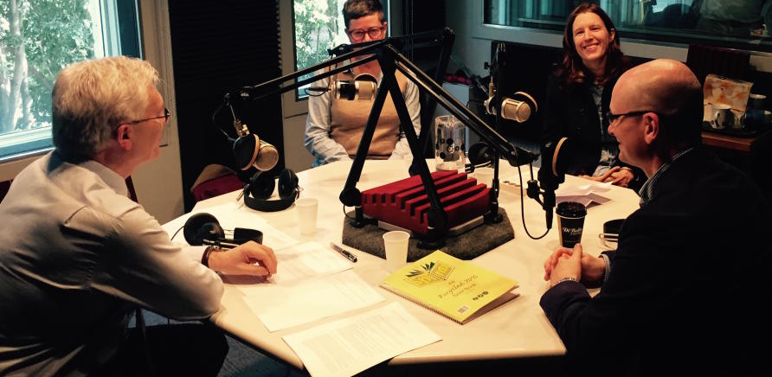
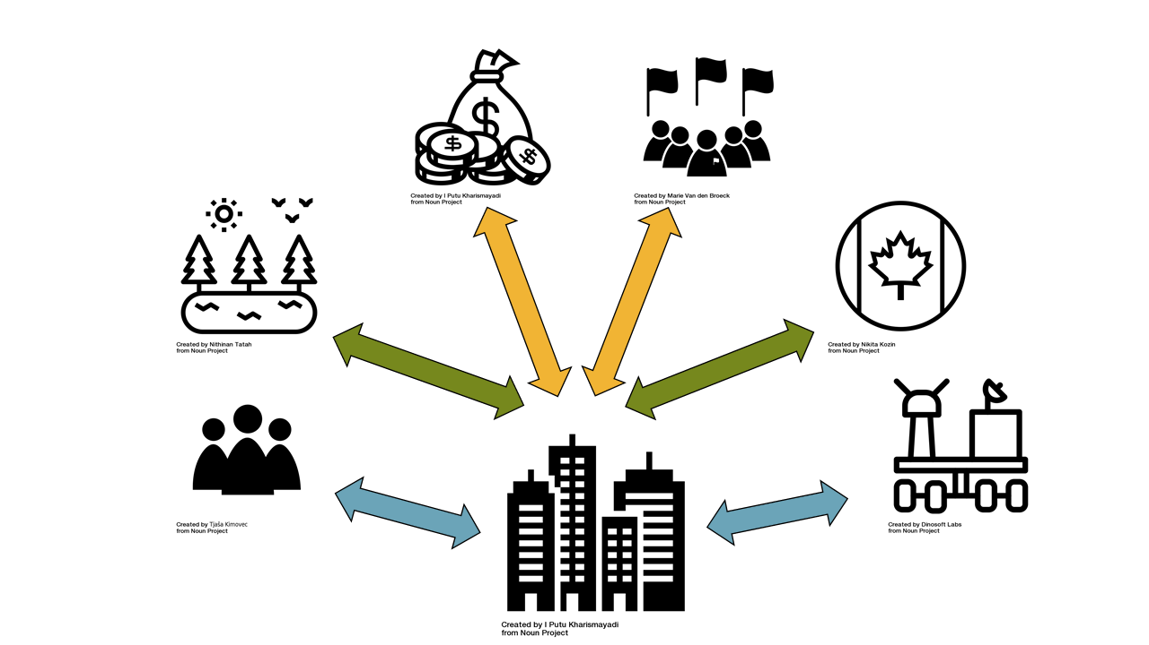
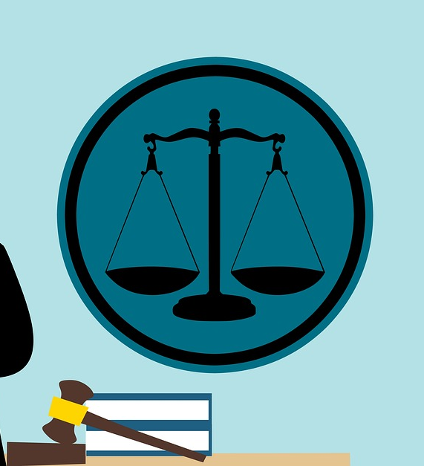
Case Study: Corporate Influence on Public Policy
Corporate lobbying and influence on public policy demonstrate the intersection of economic power and politics. This case highlights how economic interests can shape legislation and regulatory practices (Fremstad & Karger, 2011).

Slide 54
Topic 4: Political Systems and Ideologies

Slide 55
Political Systems
This Photo by Unknown Author is licensed under CC BY-SA

Slide 56
Definition and Types of Political Systems
A political system is the structure of government and political institutions within a society. It encompasses the methods through which authority is exercised and decisions are made. Major types of political systems include:
Democracy: A system where power is vested in the people, who exercise it directly or through elected representatives. Key features include free elections, political pluralism, and protection of individual rights (Dahl, 1989).
Authoritarianism: A system where power is concentrated in the hands of a single ruler or a small group. It typically features limited political freedoms, centralised control, and limited public participation (Linz, 2000).

Slide 57
Continuation…
Totalitarianism: An extreme form of authoritarianism where the state seeks to control all public and private life aspects. It is characterized by a single ruling party, a central ideology, and pervasive surveillance (Arendt, 1951).
Monarchy: A system where a single individual, the monarch, holds supreme authority. Monarchies can be absolute (with total control) or constitutional (where the monarch's powers are limited by a constitution) (Kishlansky et al., 2008).

Slide 58
Continuation…
Socialism: A system where the state or collective ownership is central to managing the economy and providing social welfare. It emphasizes reducing income inequality and providing universal services (Giddens, 2006).
Communism: An ideology advocating for a classless society where the means of production are communally owned, aiming to eliminate private property and economic disparities (Marx & Engels, 1848).

Slide 59
Characteristics of Political Systems
Political systems can be distinguished by:
Authority Structure: The distribution of power and decision-making processes (Weber, 1947).
Political Participation: How citizens engage in the political process (Dahl, 1989).
Rule of Law: The extent to which laws apply equally to all citizens and are enforced impartially (Friedman, 2005).

Slide 60
Political Ideologies

Slide 61
Definition and Purpose of Ideologies
Political ideologies are sets of beliefs and values that shape political attitudes and actions. They provide frameworks for understanding political phenomena and guide policy-making (Heywood, 2007).

Slide 62
Major Political Ideologies
Liberalism: Emphasizes individual freedoms, democracy, and the protection of human rights. It supports market economies with some state intervention to address inequalities (Rawls, 1971).
Conservatism: Focuses on preserving traditional values, institutions, and social order. It advocates for gradual change and often supports free market policies (Burke, 1790).
Socialism: Advocates for social ownership of the means of production and emphasizes reducing social inequality. Socialists support strong welfare systems and public services (Giddens, 2006).

Slide 63
Continuation…
Communism: Aims for a classless society where all property is publicly owned and each person works and is paid according to their abilities and needs (Marx & Engels, 1848).
Fascism: A far-right ideology characterized by authoritarian nationalism, dictatorial power, and suppression of opposition. It often includes elements of racial superiority and militarism (Mouffe, 2005).
Anarchism: Advocates for a society without formal government or hierarchical structures, emphasizing voluntary cooperation and mutual aid (Kropotkin, 1902).

Slide 64
Ideological Impacts on Governance
Different ideologies shape governance practices and policy priorities. For instance:
Liberal Democracies: Emphasize individual rights, democratic processes, and market economies.
Socialist Governments: Focus on social equality, public welfare, and state intervention in the economy.
Authoritarian Regimes: Centralize power and limit political freedoms, often prioritizing stability over individual rights.

Slide 65
Comparative Analysis of Political Systems
S/NO | DEMOCRACY | AUTHORITARIANISM
1. | Encourages participation | Concentrates power
2. | Accountability | Often suppresses dissent
3. | The protection of freedoms | Limits political participation

Slide 66
Monarchy vs. Republic
S/NO | Monarchy | Republic
1. | Can be absolute or constitutional | Emphasizes elected representatives
2. | With varying degrees of power vested in the monarch | The absence of hereditary rule

Slide 67
Socialism vs. Capitalism
S/NO | Socialism | Capitalism
1. | Seeks to address inequality through state control and redistribution | Focuses on private ownership
2. |  | Market-driven economies
3. |  | Limited state intervention

Slide 68
Case Studies and Examples
This Photo by Unknown Author is licensed under CC BY-SA-NC

Slide 69
Case Study: The Nordic Model
The Nordic countries (Sweden, Denmark, Norway) combine democratic governance with extensive social welfare systems, illustrating a blend of socialism and capitalism (Esping-Andersen, 1990).

Slide 70
Case Study: The Rise of Authoritarian Regimes
Examines recent trends in authoritarianism in countries like Russia and Venezuela, highlighting the shift towards centralized control and diminished democratic practices (Levitsky & Way, 2010).

Slide 71
Topic 5: Nationalism, Ethnicity, and State Building

Slide 72
Nationalism
Definition and Historical Development
Nationalism is a political ideology centred on the belief that a nation should be congruent with the state. It emphasizes the interests, culture, and identity of a particular nation and often seeks to establish or maintain a nation-state (Smith, 1991).

Slide 73
Continuation…
Early Nationalism: Emerged in Europe during the late 18th and early 19th centuries, driven by the French Revolution and the desire for self-determination (Hobsbawm, 1990).
Modern Nationalism: Continues to shape political landscapes globally, influencing movements for independence and national unity (Anderson, 1983).

Slide 74
Types of Nationalism
Civic Nationalism: Focuses on shared values, citizenship, and legal equality. It promotes inclusion and integration based on common civic principles (Kohn, 1967).
Ethnic Nationalism: Bases nationhood on ethnicity, culture, and heritage, often leading to exclusionary practices (Geertz, 1973).
Religious Nationalism: Merges national identity with religious identity, influencing policies and state functions (Juergensmeyer, 1993).

Slide 75
Impact on State Building
Nationalism can both support and hinder state building:
Supportive Impact: Fosters unity and identity, facilitating the creation of stable nation-states (Smith, 1991).
Hindering Impact: This can lead to ethnic conflicts and separatism if not managed inclusively (Brown, 2000).

Slide 76
Ethnicity
Definition and Characteristics
Ethnicity refers to shared cultural practices, language, and heritage that distinguish one group from another. It is a key component of identity and can play a significant role in political dynamics (Barth, 1969).

Slide 77
Continuation…
Ethnic Identity: Formed through common ancestry, language, and cultural practices (Giddens, 2006).
Ethnic Conflict: This occurs when ethnic groups compete for resources, power, or recognition, often exacerbating tensions within multi-ethnic states (Horowitz, 1985).

Slide 78
Ethnic Politics and State Building
Ethnic politics involves the pursuit of ethnic interests within the political arena, which can affect state-building processes:
Ethnic Federalism: A system where political power is distributed among ethnic groups to promote autonomy and reduce conflict (Rex & Singh, 1986).
Ethnic Mobilization: The process of organizing ethnic groups to achieve political goals, which can impact national unity and governance (Berman, 1998).

Slide 79
State Building
Definition and Processes
State building refers to the construction and strengthening of state institutions and governance structures. It involves creating effective and legitimate state mechanisms (Rotberg, 2004).

Slide 80
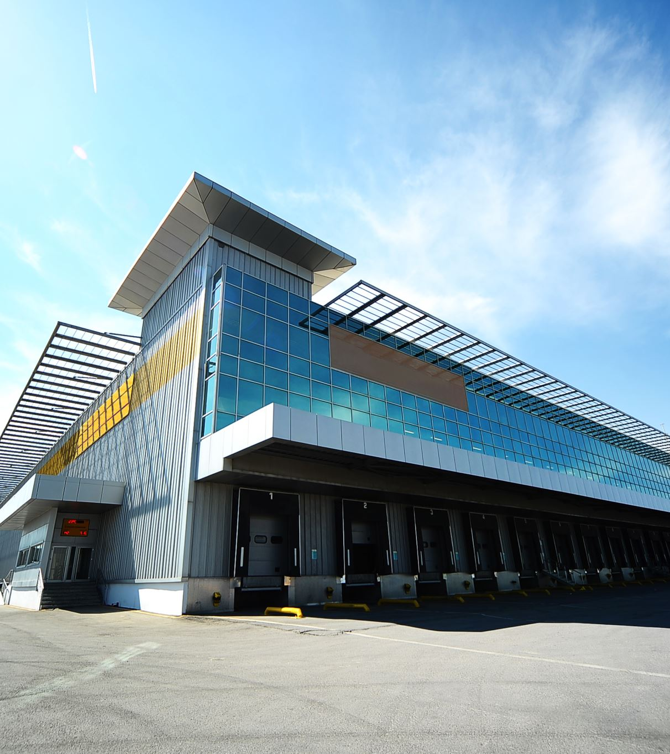
Continuation…
Institutional Development: Building institutions that are capable of delivering public services, enforcing laws, and maintaining order (Miller, 2010).
Nation-Building: Efforts to foster national identity and cohesion within a state, often involving integration of diverse groups (Gellner, 1983).

Slide 81
Challenges in State Building
Conflict and Division: Ethnic and nationalist conflicts can disrupt state building efforts and lead to fragmentation (Tilly, 2007).
Institutional Weakness: Developing effective institutions in post-conflict or newly independent states can be challenging due to lack of resources and expertise (Migdal, 2001).

Slide 82
Case Studies
Case Study: Post-Soviet States: Examines how nationalism and ethnicity have influenced state-building in former Soviet republics (Hann, 2002).
Case Study: South Sudan: Analyzes the impact of ethnic conflict on the state-building process in South Sudan (Deng, 2010).

Slide 83
Topic 6: Civil Society, NGOs, and Governance

Slide 84
Civil Society
Definition and Characteristics
Civil society refers to the realm of organized social life that is voluntary, self-generating, and autonomous from the state. It includes a diverse array of organizations and groups that work to promote collective interests and values (Edwards, 2004).

Slide 85
CONTINUATION…
Components of Civil Society: Includes non-profit organizations, community groups, faith-based organizations, and social movements (Anheier, 2004).
Role in Democracy: Acts as a check on government power, promotes public participation, and fosters social capital (Putnam, 2000).
This Photo by Unknown Author is licensed under CC BY-SA
This Photo by Unknown Author is licensed under CC BY-SA
This Photo by Unknown Author is licensed under CC BY-ND
This Photo by Unknown Author is licensed under CC BY-SA-NC
This Photo by Unknown Author is licensed under CC BY-NC-ND

Slide 86
Historical Development
Early Examples: In the 18th and 19th centuries, civil society played a critical role in advocating for social reforms and political change (Tocqueville, 2000).
Modern Civil Society: Has evolved to address a wide range of issues including human rights, environmental protection, and social justice (Sampson, 2002).

Slide 87
Impact on Governance
Advocacy and Accountability: Civil society organizations (CSOs) often advocate for policy changes and hold governments accountable for their actions (Sullivan, 2007).
Service Provision: In many cases, CSOs provide essential services that complement or supplement state functions (Lewis, 2001).
This Photo by Unknown Author is licensed under CC BY
This Photo by Unknown Author is licensed under CC BY
This Photo by Unknown Author is licensed under CC BY
This Photo by Unknown Author is licensed under CC BY

Slide 88
Non-Governmental Organizations (NGOs)
Definition
NGOs are organizations that operate independently from the government and are usually focused on addressing social, environmental, or developmental issues (Salamon, 1999).
This Photo by Unknown Author is licensed under CC BY-SA-NC
This Photo by Unknown Author is licensed under CC BY-SA
This Photo by Unknown Author is licensed under CC BY
This Photo by Unknown Author is licensed under CC BY-NC
This Photo by Unknown Author is licensed under CC BY-NC

Slide 89
Types of NGOs:
Operational NGOs: Focus on delivering services and implementing projects (Rogers, 2003).
Advocacy NGOs: Focus on influencing policy and raising awareness about specific issues (Jordan & Hutton, 2003).

Slide 90
Role in Development
Service Delivery: NGOs often provide critical services in areas where government capacity is limited, such as healthcare and education (Kaldor, 2003).
Capacity Building: They help build local capacities and empower communities to address their own needs (Bryant & Bailey, 1997).
This Photo by Unknown Author is licensed under CC BY-SA
This Photo by Unknown Author is licensed under CC BY-SA
This Photo by Unknown Author is licensed under CC BY-SA-NC
This Photo by Unknown Author is licensed under CC BY
This Photo by Unknown Author is licensed under CC BY-SA

Slide 91
Challenges and Criticisms
Dependency and Accountability: NGOs can sometimes create dependency among local communities and may face challenges related to transparency and accountability (Bebbington et al., 2008).
Effectiveness: Questions have been raised about the effectiveness of NGOs in achieving long-term developmental goals (Lewis & Kanji, 2009).
This Photo by Unknown Author is licensed under CC BY-NC-ND
This Photo by Unknown Author is licensed under CC BY-NC
This Photo by Unknown Author is licensed under CC BY

Slide 92
Governance and Civil Society
Theoretical Frameworks
Good Governance: Emphasizes the importance of transparency, accountability, and participation in the governance process (UNDP, 1997).
Governance Networks: Civil society and NGOs are key actors in governance networks that include state and market actors (Rhodes, 1997).
This Photo by Unknown Author is licensed under CC BY-NC-ND
This Photo by Unknown Author is licensed under CC BY-SA
This Photo by Unknown Author is licensed under CC BY-NC-ND
This Photo by Unknown Author is licensed under CC BY-NC-ND
This Photo by Unknown Author is licensed under CC BY-NC-ND

Slide 93
Civil Society’s Role in Governance
Policy Influence: CSOs and NGOs contribute to policy-making by providing expertise and advocating for marginalized groups (Peters, 2010).
Monitoring and Evaluation: They play a role in monitoring government performance and evaluating the impact of policies and programs (Miller, 2001).
This Photo by Unknown Author is licensed under CC BY-SA-NC
This Photo by Unknown Author is licensed under CC BY-SA
This Photo by Unknown Author is licensed under CC BY-NC-ND
This Photo by Unknown Author is licensed under CC BY-ND

Slide 94
Case Studies
Case Study: Kenya: Examines the role of civil society and NGOs in promoting democratic governance and development (Gulilat, 2013).
Case Study: India: Analyzes how NGOs have influenced policy and governance in the context of rural development (Reddy, 2004).

Slide 95
Topic 7: Human Rights and Development

Slide 96
Introduction to Human Rights
Definition and Evolution
Definition: Human rights are the fundamental rights and freedoms to which every individual is entitled, regardless of nationality, gender, ethnicity, or religion (UN, 1948).
Evolution: The concept of human rights has evolved from basic freedoms to a broader set of rights including economic, social, and cultural rights (Donelly, 2003).

Slide 97
Key Human Rights Documents
Universal Declaration of Human Rights (UDHR): Adopted in 1948, it serves as a foundational document outlining fundamental human rights (UN, 1948).
International Covenants: Includes the International Covenant on Civil and Political Rights (ICCPR) and the International Covenant on Economic, Social, and Cultural Rights (ICESCR) (UN, 1966).

Slide 98
Human Rights and Development

Slide 99
Conceptual Framework
Human Rights-Based Approach (HRBA): Integrates human rights principles into development practices, emphasizing accountability, participation, and non-discrimination (UNICEF, 2007).
Development as Freedom: Argues that development should be viewed as a process of expanding freedoms and capabilities (Sen, 1999).
This Photo by Unknown Author is licensed under CC BY-SA
This Photo by Unknown Author is licensed under CC BY

Slide 100
Key Principles
Equality and Non-Discrimination: Ensures that development benefits are equitably distributed among all segments of society (Kabeer, 2005).
Participation: Encourages the active involvement of individuals and communities in decision-making processes that affect their lives (Cornwall & Gaventa, 2001).
Accountability: Demands that duty-bearers (e.g., governments) are held accountable for fulfilling human rights obligations (Robinson, 2003).

Slide 101
Implementation Challenges
Resource Allocation: Ensuring that resources are allocated in a way that respects and promotes human rights (De Schutter, 2009).
Institutional Capacity: Building the capacity of institutions to effectively promote and protect human rights within development contexts (UNDP, 2006).

Slide 102
Human Rights and Development Policies

Slide 103
International Frameworks
Millennium Development Goals (MDGs): Emphasized poverty reduction and had an implicit human rights dimension (UN, 2000).
Sustainable Development Goals (SDGs): Integrate human rights principles more explicitly, focusing on inclusion, equality, and justice (UN, 2015).

Slide 104
The Role of Civil Society in Promoting Human Rights

Slide 105
Advocacy and Monitoring
Advocacy: Civil society organizations (CSOs) advocate for the realization of human rights and influence policy changes (Gready & Ensor, 2005).
Monitoring and Reporting: CSOs play a critical role in monitoring human rights violations and reporting on progress (Hossain et al., 2014).
This Photo by Unknown Author is licensed under CC BY-SA

Slide 106
Capacity Building and Education
Training: Providing education and training on human rights to communities and government officials (Sikkink, 2004).
Empowerment: Empowering marginalized groups to claim their rights and participate in development processes (Batliwala, 2007).

Slide 108
Topic 8: Political Economy and Development

Slide 109
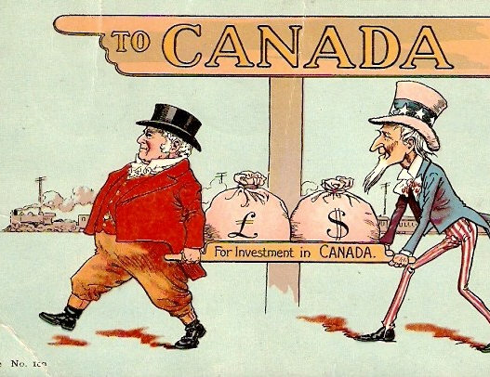
Introduction to Political Economy
Definition: Political economy examines the relationship between political and economic systems, focusing on how policies, institutions, and governance affect economic outcomes and development (Oatley, 2019).
Scope: It includes an analysis of how political power influences economic decisions and how economic conditions shape political structures (Dahl, 1989).

Slide 110
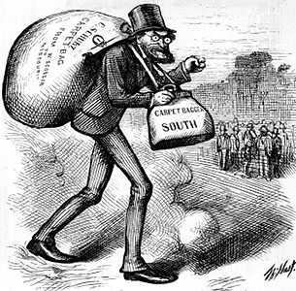
Historical Evolution
• Classical Political Economy: Rooted in the works of economists like Adam Smith and David Ricardo, focusing on market mechanisms and the role of government in economic regulation (Smith, 1776; Ricardo, 1817).
• Marxist Political Economy: Focuses on the role of class struggle and economic inequalities in shaping political and economic systems (Marx, 1867).
This Photo by Unknown Author is licensed under CC BY-SA
This Photo by Unknown Author is licensed under CC BY
This Photo by Unknown Author is licensed under CC BY-ND

Slide 111
Political Economy Theories

Slide 112
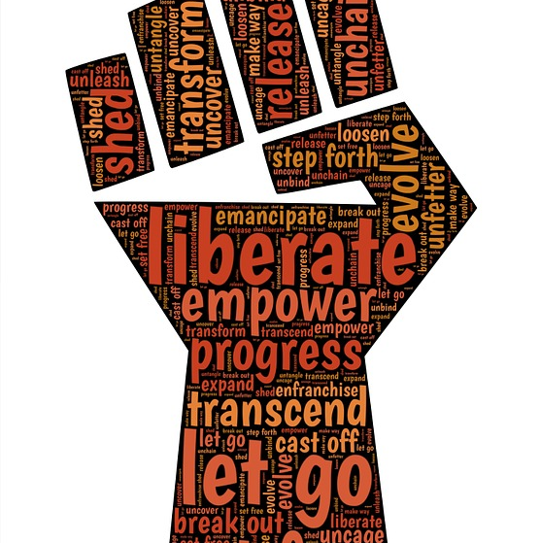
Liberalism
•Overview: This section emphasizes the role of free markets, individual freedoms, and minimal government intervention in economic affairs (Friedman, 2002).
•Key Concepts: Market efficiency, privatization, and deregulation (Hayek, 1944).

Slide 113
Marxism
• Overview: Analyzes the impact of capitalism on social inequalities and class conflict (Marx & Engels, 1848).
• Key Concepts: Surplus value, class struggle, and the state’s role in perpetuating capitalist interests (Marx, 1867).

Slide 114
Dependency Theory
• Overview: Focuses on the exploitation of developing countries by developed nations and the structural inequalities in the global economy (Frank, 1966).
• Key Concepts: Core-periphery relations, economic dependency, and underdevelopment (Wallerstein, 1974).

Slide 115
Neoliberalism
• Overview: Advocates for market-driven approaches to development, emphasizing economic liberalization, privatization, and reduced state intervention (Harvey, 2005).
• Key Concepts: Globalization, free trade, and financial deregulation (Williamson, 1990).

Slide 116
Political Economy and Development

Slide 117
Economic Growth and Development
• Economic Growth: Refers to the increase in a country's output of goods and services, typically measured by GDP (Schumpeter, 1934).
• Economic Development: Encompasses broader changes including improvements in quality of life, health, and education (Sen, 1999).
This Photo by Unknown Author is licensed under CC BY
This Photo by Unknown Author is licensed under CC BY-SA-NC
This Photo by Unknown Author is licensed under CC BY-SA

Slide 118
Role of Institutions
• Institutional Economics: Highlights the importance of institutions (rules, norms, and organizations) in shaping economic outcomes and development (North, 1990).
• Good Governance: Effective governance and institutional quality are crucial for sustainable development (Kaufmann et al., 1999).
This Photo by Unknown Author is licensed under CC BY
This Photo by Unknown Author is licensed under CC BY
This Photo by Unknown Author is licensed under CC BY

Slide 119
Globalization and Development
• Positive Aspects: Globalization can lead to increased economic opportunities, technological transfer, and market access (Stiglitz, 2002).
• Negative Aspects: It can also exacerbate inequalities, cultural homogenization, and environmental degradation (Rodrik, 1997).

Slide 120
Policy Implications
Development Strategies
• Inclusive Development: Policies aimed at reducing inequalities and ensuring that economic growth benefits all segments of society (UNDP, 2010).
• Sustainable Development: Balancing economic growth with environmental protection and social equity (WCED, 1987).
Role of International Organizations
• International Monetary Fund (IMF): Provides financial assistance and policy advice to member countries (IMF, 2020).
• World Bank: Focuses on reducing poverty and supporting development projects (World Bank, 2020).

Slide 121
Development Strategies
• Inclusive Development: Policies aimed at reducing inequalities and ensuring that economic growth benefits all segments of society (UNDP, 2010).
• Sustainable Development: Balancing economic growth with environmental protection and social equity (WCED, 1987).

Slide 122
Role of International Organizations
• International Monetary Fund (IMF): Provides financial assistance and policy advice to member countries (IMF, 2020).
• World Bank: Focuses on reducing poverty and supporting development projects (World Bank, 2020).

Slide 123
Topic 9: Globalization and Its Impact on Development

